Slide 1

Chapter 6
Health Services Financing

Slide 2
Learning Objectives (1 of 2)
Role of health care financing and its impact
Concept of insurance and general terminology
Differentiate group insurance, self-insurance, individual health insurance, managed care, high-deductible, and Medigap plans
Trends in employer-based health insurance
Features of public insurance programs

Slide 3
Learning Objectives (2 of 2)
Various methods of reimbursement and trends
National health care and personal health care expenditures and trends
Effects of ACA on financing and insurance
Current directions and issues in health care financing

Slide 4
Introduction
Complexity of financing in the U.S.
Public and private financing play roles.
Insurance overlap is common.
Insurance financing shared between employer and employee.
ACA attempted to facilitate insurance purchase.

Slide 5
Role and Scope of Health Services Financing (1 of 2)
Financing pays health insurance premiums.
Charity plays a noteworthy role for uninsured.
Insurance increases demand for health care.
Insurance lowers out-of-pocket costs.
Patients consume more.
Leads to higher utilization or moral hazard.

Slide 6
Role and Scope of Health Services Financing (2 of 2)
Financing influences on supply-side factors.
New models of organization may form.
Demand-side factors.
Financing influences the supply and distribution of health professionals.
Resource-based relative value scale (RBRVS).

Slide 7
Financing and Cost Control
Insurance extension to uninsured increases health care expenditures (E).
Insurance with payment (price = P) influences supply.
Insurance and supply of services determine access and service utilization (quantity of services consumed = Q).
E = P × Q

Slide 8
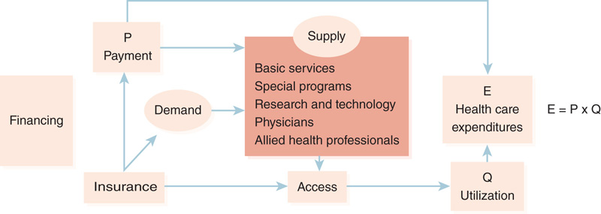
Figure 6-1: Influence of financing on the delivery of health services.

Slide 9
Insurance Function
Four fundamental principles
Risk is unpredictable for the insured.
Risk can be predicted with a reasonable accuracy.
Insurance mechanism transfers risk from the individual to the group.
Members of insured group share losses.

Slide 10
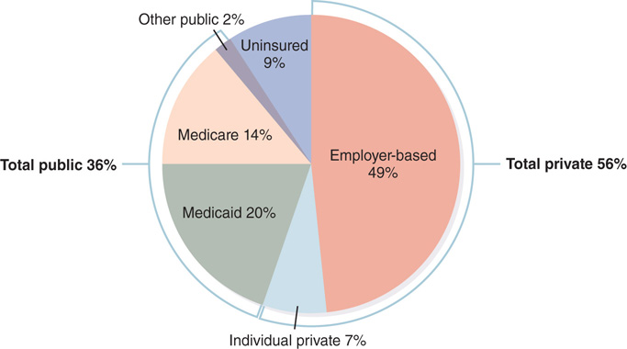
Figure 6-2: Health insurance status of the total U.S. population, 2015.
Data from Kaiser Family Foundation. 2017. Health insurance coverage of the total population. Timeframe: 2015. Available at: http://kff.org/other/state-indicator/total-population/?currentTimeframe=0. Accessed January 2017.

Slide 11
Private Health Insurance
Private health insurance is also called “voluntary health insurance.”
Most private health insurance is employment based.
Workers are not mandated to buy it.
Many businesses are self-insured.

Slide 12
Basic Health Insurance Terminology
Premiums
Risk rating
Experience and community ratings
Cost sharing
Deductible
Copayment
Coinsurance
Covered services or benefits

Slide 13
Types of Private Insurance (1 of 2)
Group insurance
Self-insurance
Individual private health insurance
Managed care organizations (MCOs)
Health maintenance organizations (HMOs)
Preferred provider organizations (PPOs)

Slide 14
Types of Private Insurance (2 of 2)
High-deductible health plans and savings options
Short-term stop-gap coverage
Consolidated Omnibus Budget Reconciliation Act (COBRA)
Medigap
Does not cover extended long-term care, vision, dental, hearing aids, or private nursing
Trends in private health insurance

Slide 15
Trends in Employment-Based Health Insurance
Play-or-pay mandate
Premium costs in employment-based plans
Trends in utilization costs: cost sharing
ACA limits out-of-pocket cost sharing
Deductibles and copayments/coinsurance

Slide 16
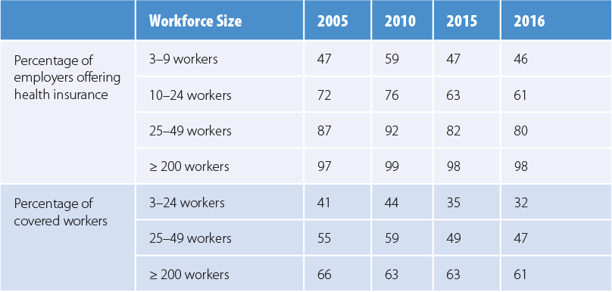
Table 6-1: Trends in Employment-Based Health Insurance, Selected Years
Data from Kaiser Family Foundation and Health Research and Educational Trust (Kaiser/HRET). 2016. Employer health benefits: 2016 annual survey. Menlo Park, CA: Author.

Slide 17
Private Coverage and Cost Under the Affordable Care Act (1 of 2)
Six main ACA provisions
Insurers mandated to enroll young adults until age 26 under parents’ plans
Illegal to charge more or refuse coverage for preexisting conditions
All health plans had to include certain “essential health benefits”.
Fee on insurers for the privilege of selling plans through the exchanges

Slide 18
Private Coverage and Cost Under the Affordable Care Act (2 of 2)
Six main ACA provisions (continued)
Medical loss ratio (MLR)
Legal U.S. residents required to have health insurance, or else pay a penalty tax
Deductibles at often-unaffordable levels
Some large insurers left ACA exchanges

Slide 19
Public Health Insurance
Public financing supports programs benefiting certain categories of people.
Medicare for elderly and disabled individuals
Medicaid for the indigent
Department of Defense programs for active service members and their families
Department of Veterans Affairs (VA) health care for military veterans

Slide 20
Medicare (1 of 2)
Title 18 of Social Security Act benefits
Those 65 years old or older
Disabled who are entitled to Social Security
Those with end-stage renal disease
Part A: Hospital Insurance

Slide 21
Medicare (2 of 2)
Part B: Supplementary Medical Insurance
Part C: Medicare Advantage
Part D: Prescription Drug Coverage
Medicare financing and spending for services
Medicare trust funds

Slide 22
Medicaid (1 of 2)
Title 19 of Social Security Act
Finances health care for the indigent
Almost entirely a taxpayer-financed program
Means-tested program
Eligibility depends on financial resources

Slide 23
Medicaid (2 of 2)
Rules for Medicaid eligibility
Dual-eligible beneficiaries
Medicaid experiences under the ACA
Issues with Medicaid
Medicaid enrollment and spending

Slide 24
Children’s Health Insurance Program (CHIP)
Title 21 of Social Security Act.
Federal block grants to states.
Covers children up to age 19.
No federal income threshold.
States cover children in families with incomes up to 200% of the FPL.

Slide 25
Health Care for the Military
U.S. Department of Defense
Known as the Military Health System.
For active duty and retirees, dependents, survivors, and former spouses.
Each branch operates its own medical facilities.
TRICARE is the insurance arm.

Slide 26
Veterans Health Administration (VHA)
Largest integrated U.S. health system
Cost control through global budgets
23 geographically distributed Veterans Integrated Service Networks (VISNs)
Civilian Health and Medical Program of the Department of Veterans Affairs (CHAMPVA)
Covers dependents of disabled veterans

Slide 27
Indian Health Service (IHS)
Comprehensive care to members of federally recognized tribes and their descendants
American Indian and Alaska Native (AIAN)
Facilities include
Hospitals and health centers
School centers
Health stations and Alaska village clinics

Slide 28
Payment Function (1 of 3)
Third-party payers
Insurance companies, managed care organizations, Blue Cross/Blue Shield, government
Payment function has two facets
Determine methods and amounts of reimbursement in advance of the delivery
Actual payment after services rendered

Slide 29
Payment Function (2 of 3)
Fee for service
Bundled payments
Resource-based relative value scale
Value-based reimbursement
Managed care approaches
Cost-plus reimbursement

Slide 30
Payment Function (3 of 3)
Prospective reimbursement
Diagnosis-related groups
Psychiatric DRG-based payment
LTC hospital payment system
Outpatient prospective payment system
Case-mix methods
Home health resource groups
Disbursement of funds

Slide 31
National Health Care Expenditures (1 of 2)
National health expenditures (NHE)
$3.2 trillion
Average per-capita spending of $9,990 per American
NHE represented 17.8% of the U.S. gross domestic product (GDP)

Slide 32
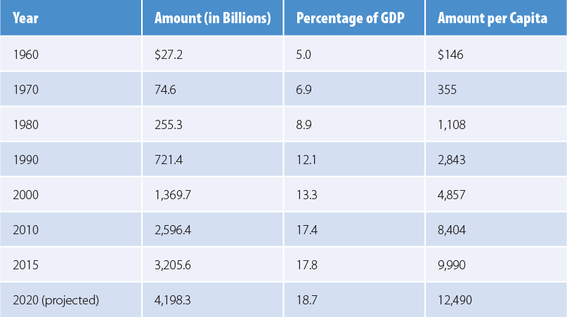
Table 6-4: U.S. National Health Expenditures in Selected Years
Data from Centers for Medicare and Medicaid Services (CMS). 2016c. National health expenditure data: Historical. Available at: https://www.cms.gov
/research-statistics-data-and-systems/statistics-trends-and-reports/nationalhealthexpenddata/nationalhealthaccountshistorical.html. Accessed
January 2017.

Slide 33
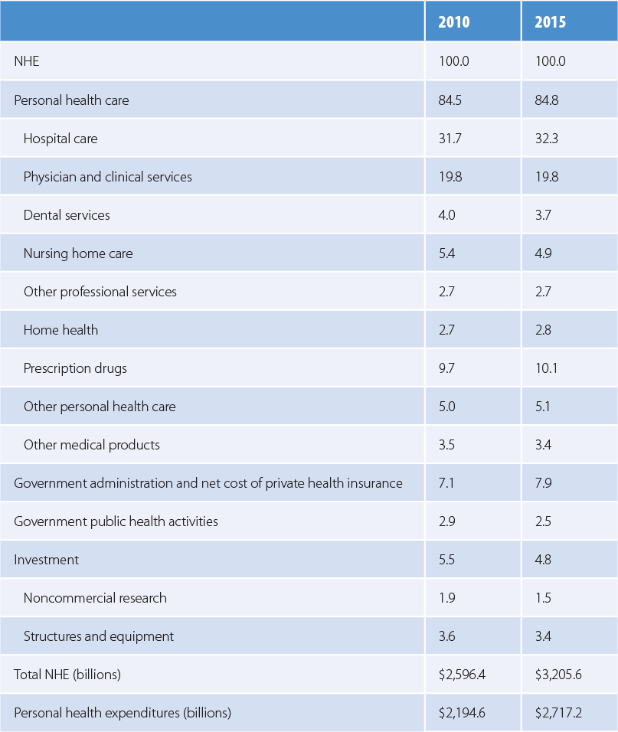
National Health Care Expenditures (2 of 2)
Differences between national and personal health expenditures
Table 6-5 Percentage Distribution of U.S. National Health Expenditures, 2010 and 2015
Data from Centers for Medicare and Medicaid Services (CMS). 2016c. National health expenditure data: Historical. Available at: https://www.cms.gov/research-statistics-data-and-systems/statistics-trends-and-reports/nationalhealthexpenddata/nationalhealthaccountshistorical.html. Accessed January 2017.

Slide 34
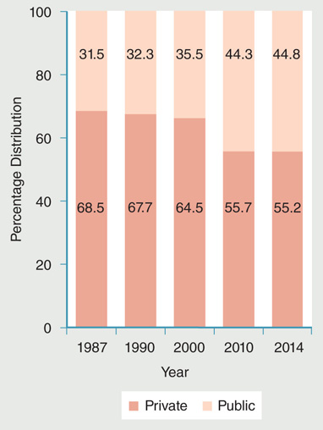
Trends in Private and Public Expenditures
Figure 6-6 Proportional distribution of U.S. private and public shares of national health expenditures.
Data from National Center for Health Statistics (NCHS). 2016. Health, United States, 2015. Hyattsville, MD: U.S. Department of Health and Human Services. pp. 310–311.

Slide 35
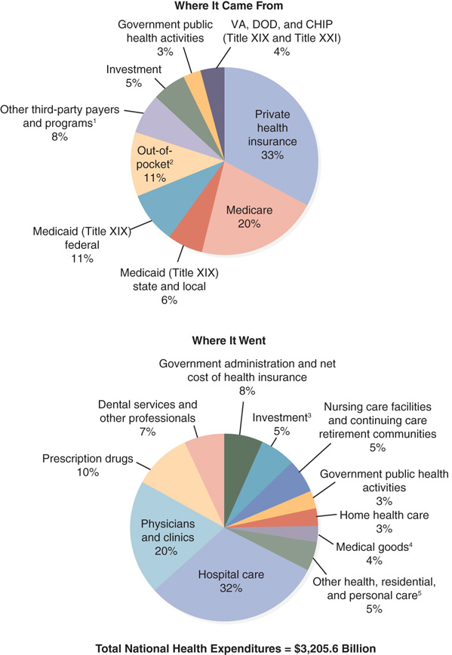
The Nation’s Health Care Dollar
Figure 6-7 The U.S. health dollar, 2015.
Data from Centers for Medicare and Medicaid Services (CMS). 2016c. National health expenditure data: Historical. Available at: https://www.cms.gov/research-statisticsdata-
and-systems/statistics-trends-and-reports/nationalhealthexpenddata/nationalhealthaccountshistorical.html. Accessed January 2017. See NHE Tables.

Slide 36
Current Directions and Issues
Value and affordability
Adverse selection
Cost shifting
Mechanism to make up for revenue shortfalls
Fraud and abuse
False Claims Act, Social Security Act, and the Anti-Kickback statute

Slide 37
Summary
Financing determines
Who pays for health care services and for whom
Who produces which types of health care services
Financing affects
Demand and supply sides of the health care equation

